Slide 1

Welcome to
F2 Expectations
Information
Sept 2025

Slide 2


Aims
To give you an understanding of the Early Years curriculum.
To give you an idea of how we help the children learn.
To share expectations.
Notes:
The early years foundation stage (EYFS) statutory framework is mandatory for all early years settings. It sets the standards that all early years providers must meet to ensure that children learn and develop well, and are kept healthy and safe.

Slide 3
Staff
Class 1 –
Miss Randall
Mrs Rickman
Ms Wollacott
Other adults:
Mrs Shelley (PE on Wednesday/Next Level enrichments)
Mrs Brenning

Slide 4


The story so far……….
We have been:
Getting to know each other.
Getting familiar with routines and expectations.
Practising organising ourselves and our belongings.
Getting to know the environment.
Building resilience.
Gathering information about the children’s starting point for learning.
BASELINE

Slide 5


Slide 6
How do we learn?
- Adult Focus and Continuous Provision
- Through Play
- Phonics
- Guided Reading
- Outdoor learning opportunities

Slide 7
The Foundation Curriculum consists of 7 areas:
3 Prime Areas:-
Personal, Social and Emotional Development
Communication and Language
Physical Development
4 specific Areas
Literacy
Mathematics
Understanding of the World
Expressive Arts and Design
EYFS Curriculum

Slide 8

Personal, Social and Emotional Development
Self-regulation
Understanding their own feelings and the feelings of others. Begin to regulate accordingly. Working towards simple goals. Giving focused attention to the teacher.
Building relationships
Work and play cooperatively, taking turns, form positive attachments to adults. Show sensitivity to their own and others’ needs.
Managing self
Be confident to try new things, show independence, resilience. Explain the reasons for rules, manage basic hygiene.

Slide 9
Physical Development
Gross Motor Skills
Negotiate space and obstacles, developing strength, balance, coordination. Running, jumping, dancing, skipping, climbing etc.
Fine Motor Skills
Hold a pencil effectively, use a range of small tools, scissors, paintbrushes. Show accuracy and care when drawing.

Slide 10
Communication and Language
Listening, attention and understanding
Listening and responding, making comments about what they have heard, hold conversations with teachers and peers.
Speaking
Participate in small group, class and one-to-one discussions, offering own ideas. Offering explanations for why things might happen, express their ideas and feelings using full sentences.

Slide 11
Expressive arts and design
Creating with Materials
Safely use and explore a variety of materials, tools and techniques. Experimenting with colour and design etc. Share their creations. Make use of props and materials when role-playing characters.
Being imaginative and Expressive
Invent, adapt and recount narratives and stories. Sing a range of well-known nursery rhymes and songs. Perform songs, rhymes, poems and stores with others.

Slide 12
Understanding the world
Past and Present
Talk about lives of people around them. Know similarities and differences between things in the past and now. Understand the past.
People, Culture and Communities
Describe their immediate environment. Know similarities and differences between religions and cultures in this country. Explain similarities and differences between life in this country and another.
The natural world
Explore the natural world around them. Know some similarities and difference between the world around them and different environments. Understand some processes and changes in the natural world.

Slide 13
Literacy
Comprehension.
Demonstrate understanding of what has been
read to them by retelling stories and narratives
using their own words and recently introduced
vocabulary.
Anticipate (where appropriate) key events
in stories.
Use and understand recently introduced vocabulary during discussions about stories, non fiction, rhymes and poems and during role play

Slide 14
Literacy
Word Reading
Say a sound for each letter in the alphabet and at
least 10 digraphs.
Read words consistent with their phonic
knowledge by sound-blending.
Read aloud simple sentences and books that are
consistent with their phonic knowledge, including
some common exception words

Slide 15
Literacy
Writing
Write recognisable letters, most of which are
correctly formed.
Spell words by identifying sounds in them and
representing the sounds with a letter or letters.
Write simple phrases and sentences that can be
read by others.

Slide 16
Maths
NUMBER
NUMERICAL PATTERN
Have a deep understanding of number to 10,
including the composition of each number.
Subitise up to 5.
Automatically recall (without reference to
rhymes, counting or other aids) number bonds
up to 5 (including subtraction facts) and some
number bonds to 10, including double facts.
Verbally count beyond 20.
Compare quantities up to 10 in different contexts. Recognising when one quantity is greater than, less than or the same.
Explore and represent patterns within numbers up to 10, including evens and odds, double facts and sharing equally.

Slide 17


We follow the White Rose scheme of work.
We like this because:
New learning is taught in small, progressive steps.
It has a Concrete-Pictorial-Abstract (C-P-A) approach so that children can tackle new, abstract
concepts more comfortably.
New procedures are modelled and resources are used to help children to understand what they
are learning.
Previously learned knowledge, concepts and procedures are regularly revisited.
It encourages rich mathematical talk.
It helps children to problem-solve by building on prior learning to help them see connections and
patterns.
It encourages a growth mindset. Characters are hard-working, enthusiastic and not afraid to make
mistakes.

Slide 18

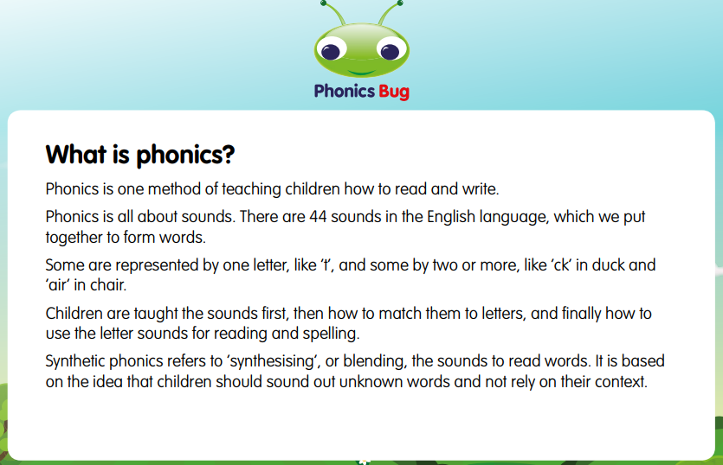
PHONICS

Slide 19
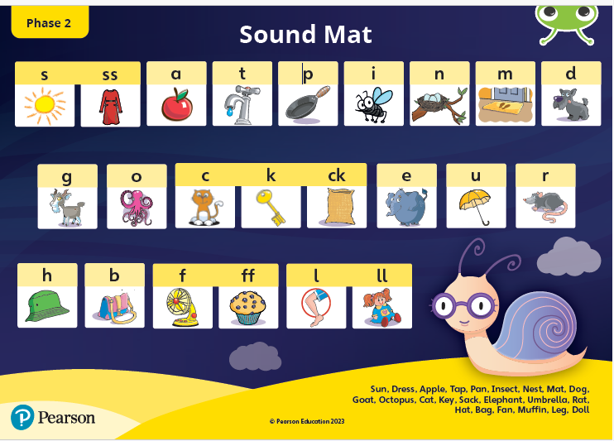
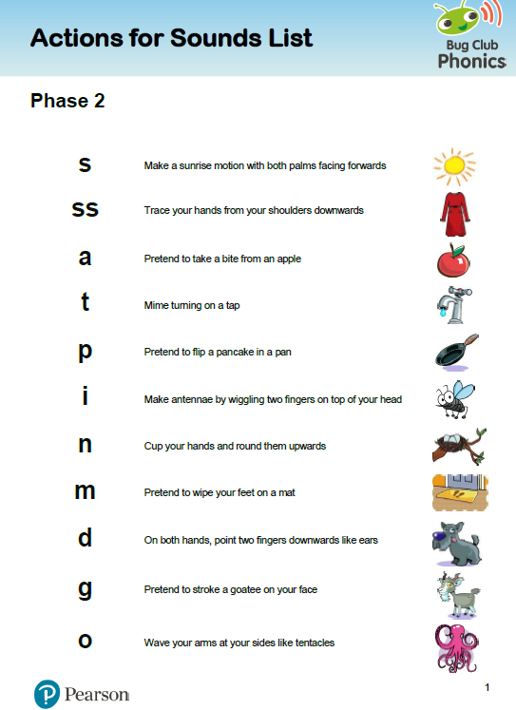

Slide 20

PHONICS

Slide 21
Supporting Reading
Your child should bring a book bag to school.
Reading Books and Reading Diaries
Balloon words.
Active Learn.
Book Shop
Reading Pup

Slide 22
PE
- Wednesday
- Enrichment/yoga Fridays.
- Continue to practise getting changed at home.
- Provide plasters to cover earrings
- LABEL P.E kit!
-Let children know what is theirs.

Slide 23
End of foundation stage
At the end of the Foundation Stage,children will be assessed in each of the 7 areas as being either:
- Below expectations
- Meeting expectations

Slide 24
Extras
Website
Family Box
SALT
Reading Pup
SALT
https://www.standhillinfants.co.uk

Slide 25
Please, please, please:
Ensure children’s clothing and belongings are clearly labelled.
Your child has a water bottle each day.
We are kept up to date with pick up information and we have details of at least two contacts.

Slide 26
Remember!
Any problems however small, please get in touch. You can use the class email to contact us or arrange a suitable time for us to talk on the phone.
Class 1 – class1@standhill.notts.sch.uk

