Slide 1
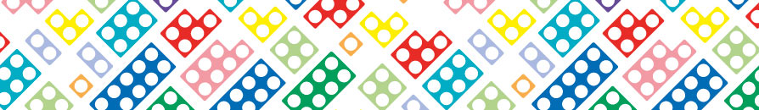
About Numicon
Here is some information so you know how we use this in school.

Slide 2
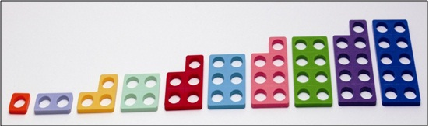
l
At Standhill we use lots of different manipulatives to support children’s mathematical learning.
Our key one is called NUMICON.
Notes:
1 changes the property of the number. A very simple activity but it is the beginnings of reasoning about number.
REGULARITY AND STRUCTURE. TANGIBLE!
Remember we are always leaying the foundations for later learning!!!

Slide 3
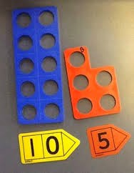
Numbers are an abstract concept.
Numerals are an arbitrary system.
NUMICON makes numbers
real for children!
Notes:
Use anything. Importance of realness of what that numeral means.
Need to see it represented differently.
Then make in the shape of the numicon tiles.

Slide 4
PATTERN
Seeing a pattern is at the heart of mathematical thinking.
Notes:
Why is this so effective???
Clearly see why 4 is one more than 3 and one less than 5. ODD AND EVEN
We assume that when we recite numbers children are seeing the pattern but digits have no real meaning!
Can add the numerals. Leads to an understanding of place value.
PLAY DISRUPT THE PATTERN!!

Slide 5
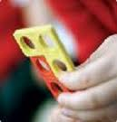
Makes numbers more real and number relationships real.
Pattern based.
Multi sensory.
Tangible and robust.
Seeing and doing.
Interactive- enhances
discussion and reasoning.
The following slides will show you some of the ways it is used and how it is a really strong visual to pin learning on.

Slide 6
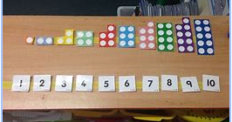

Slide 7
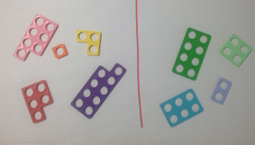
Odd Even

Slide 8
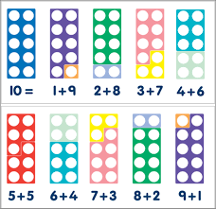
Number Bonds

Slide 9
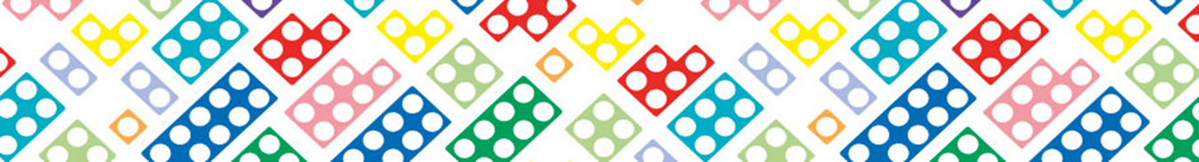
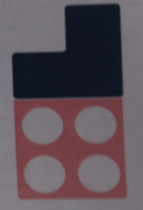
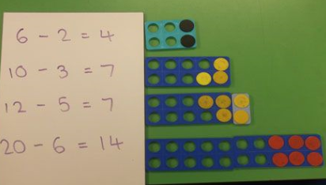

Slide 10
Multiplying
Notes:
The language is important. It is repeated addition!! 4 lots of 5 is not the same as 5 lots of 4!
Imp. because of when we come to division.

Slide 11
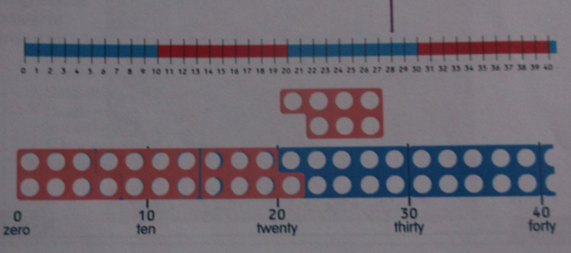
Division
Notes:
Inverse of repeated addition
How many 7s can fit into 28?

Slide 12
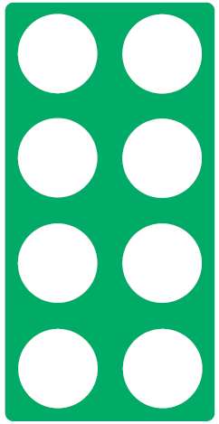
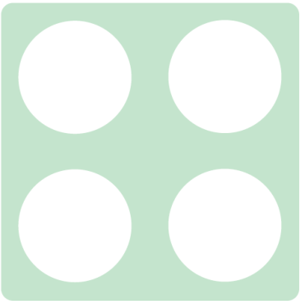


Double 4 is ?
8

Slide 13
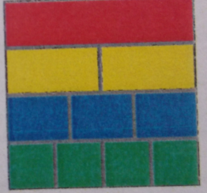
Fractions
Notes:
Cuisenaire don’t match the numicon colours.
What if the top was the value of 24? How much would the blue be worth?
Other ideas – fill half the peg board/ a quarter of the peg board etc.

Slide 14
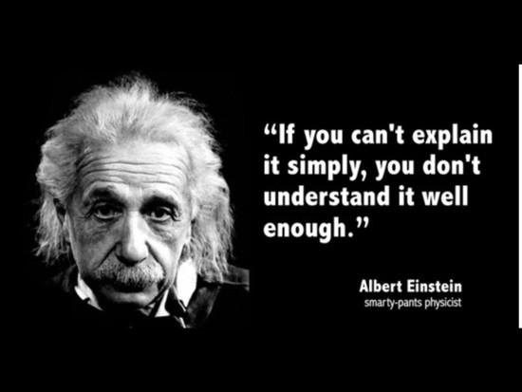

Slide 15


