Slide 1
Welcome
How your child is learning to become a Mathematician.

Slide 2
AIMS
To give you an understanding of the expectations of the maths curriculum.
To give you an understanding of how your children are taught.

Slide 3
F2
Numbers
Shape Space and Measures

Slide 4
Year 1
Number and Place Value Measures
Addition and Subtraction Shape/Geometry
Multiplication and Division
Fractions

Slide 5
Year 2
Number and Place Value Measures
Addition and Subtraction Shape/Geometry
Multiplication and Division Statistics
Fractions

Slide 6
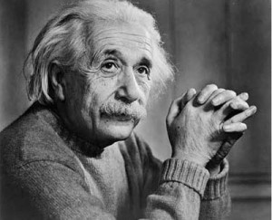
Making good mathematicians
PROBLEM SOLVING
REASONING
FLUENCY

Slide 7
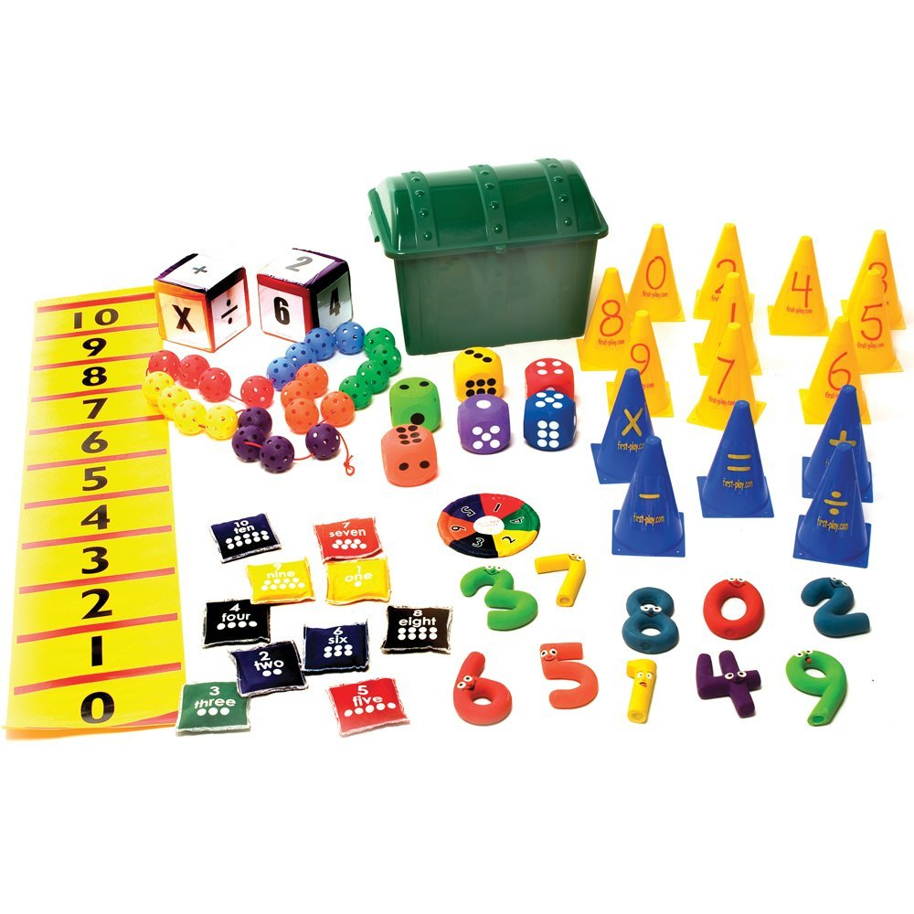
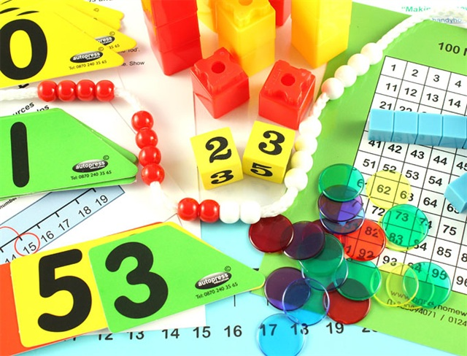
CPA
Children are encouraged to learn through the stages of concrete (using manipulatives such as Numicon and cubes), Pictorial (pictures and jottings) and then to abstract ( knowing answers, calculating in head and using prior knowledge.)

Slide 8
Addition
+
what is... altogether?
what is the sum of...?
what is.... in total?
what is... plus ...?

Slide 9
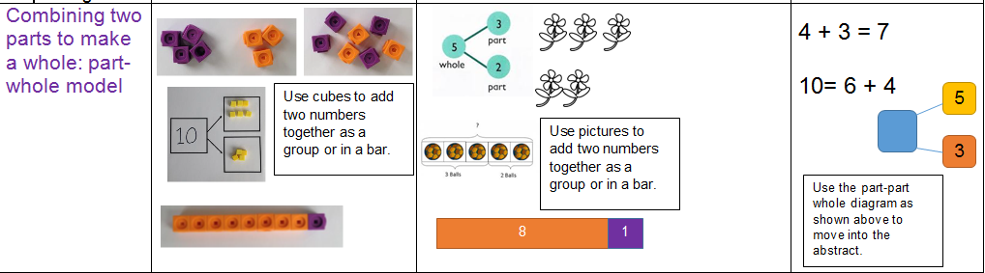
Combining 2 parts to make a whole
Notes:
Give example of coat hanger
Importance of moving add and equals around.
RELATIONSHIPS BETWEEN addition and subtraction

Slide 10
Adding pairs of two digit numbers
Find the total of 45 and 23
45 +23 40 + 5
20 + 3
60 + 8 = 68

Slide 11
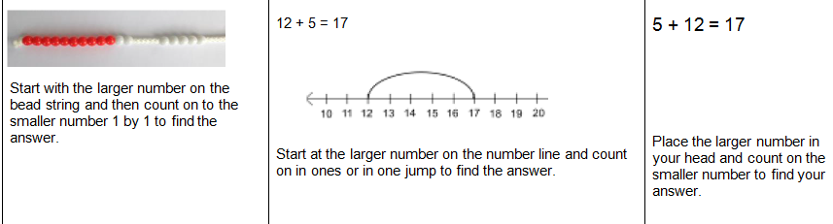
COUNTING ON
Notes:
Number lines, bigger number in head
For year 2s working with bigger no. may use an empty no .line

Slide 12
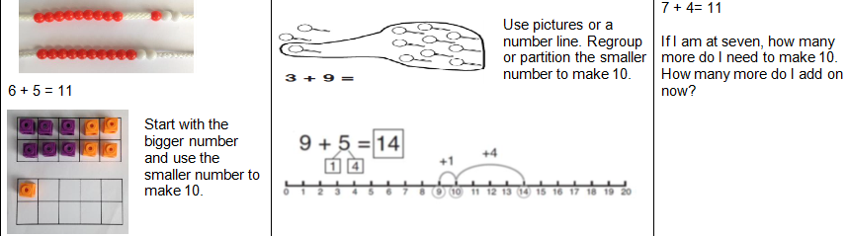
ReGrouping to make 10

Slide 13
Subtraction
what is... take away ...?
what is the difference between...?
what is...subtract ...?
what is... minus ...?
Notes:
Importance of relating as inverse of addition

Slide 14
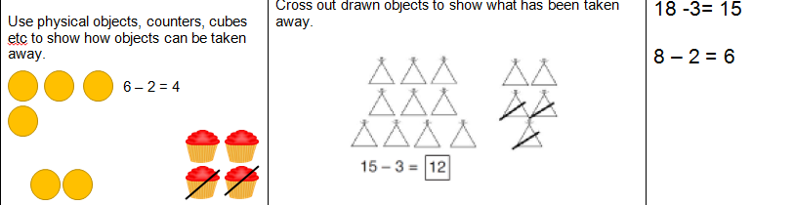
Taking away

Slide 15
COUNTING BACK
Notes:
Can also turn it into counting on/forward

Slide 16
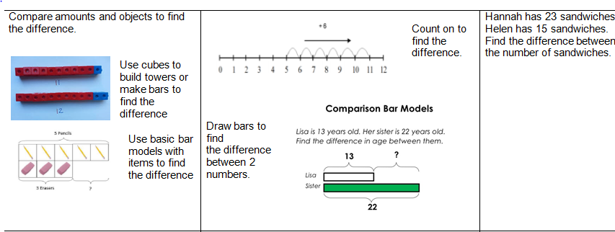
FINDING THE DIFFERENCE
Notes:
Use number line to 90-74= Find the difference by counting on from 74 to 90

Slide 17
Multiplication
what is 3 groups of 2?
X
what is 3 lots of 2?
what is 2 multiplied by 3?
2 x 3 =
(2 three times)
Notes:
Importance of understanding it as repeated addition

Slide 18
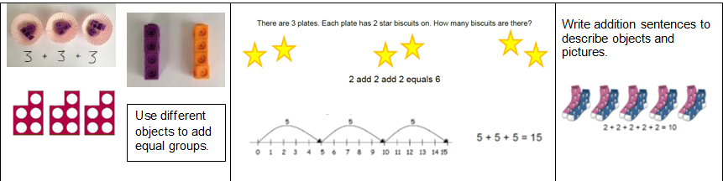
Repeated Addition

Slide 19
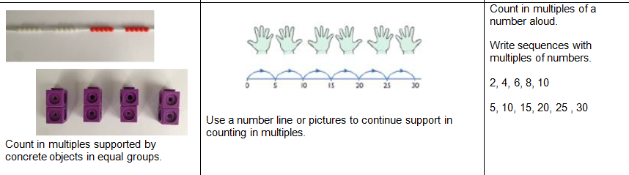
Counting in multiples

Slide 20
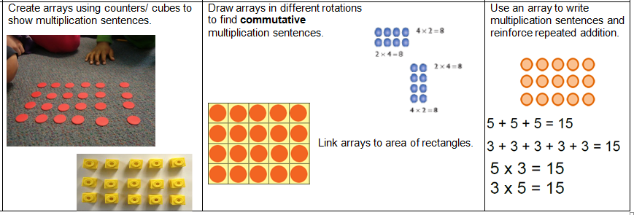
ARRAYS

Slide 21
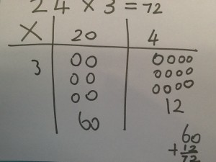
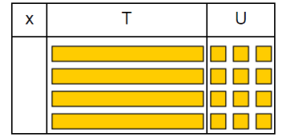
GRID METHOD

Slide 22
÷
Division
Can you put ten cubes into groups of 2?
How many groups did you make?
can you cut the cake in half?
There are six sweets, how many children can have 2 each?

Slide 23
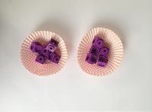
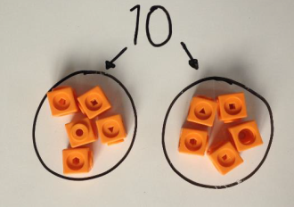
Sharing Objects into groups

Slide 24
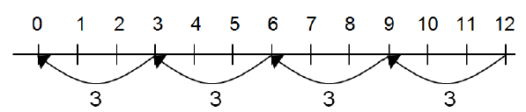
Sharing into…….

Slide 25
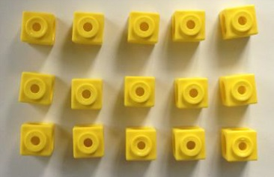
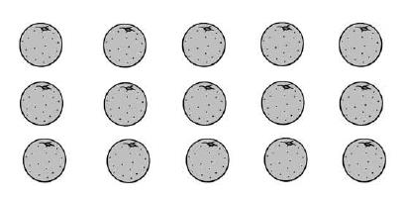
Dividing into arrays

Slide 26
BUILDING NUMBER FLUENCY
Counting objects, steps etc.
Count forwards and backwards starting and stopping at different numbers.
Reading and writing numbers to 100. (NUMERALS)
Read and write numbers to 100 (WORDS)
Counting in 2s, 5s and 10s.
Count in 3s.
Know number bonds within 10 and then beyond.
Days of the week, months of the year.
O Clock, half past, quarter past and quarter to.
Talk and explain.

Slide 27
Useful Websites
Children make progress best as mathematicians when they regularly repeat skills and practise them until they become embedded.
Children learn best when they are having fun and that's what games are for!
Primary Games You'll find all sorts of maths content here, all presented as engaging games and challenges.
Maths Zone Another collection of games and activities across the full range of curriculum content, mostly appropriate to our KS2 pupils.
Topmarks Lots of fun games to play with children of all ages!
Active learn
National Numeracy Parent Toolkit has a wealth of tips and advice for parents.
http://www.nnparenttoolkit.org.uk/
• Oxford Owl includes a range of activities, top tips and eBooks to help your child with their maths at home.
http://www.oxfordowl.co.uk/maths-owl/maths

Slide 28
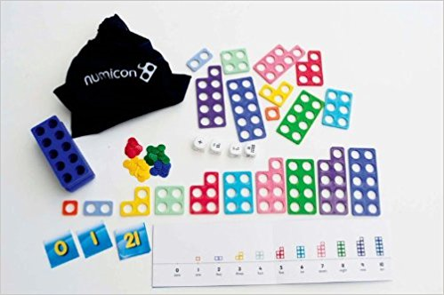
COMING SOON……..

